Slide 1
DIY PROJECT Team 22
Kaisar Imtiyaz
Ajay Kumar
Sumat Midya Chowdhuri
Harsh Sharma

Slide 2


Aim: To make an automated vacuum cleaner(AVC)
In daily life, aspects of a clean house is very important to every individual among the community. Nowadays, some of individuals think that is difficult for them to make sure their house is always in clean conditions. This is because, they are too busy in their daily routine and do not have time to clean their house. Besides that, most of them also consider that all the cleaning jobs will take a long time and use a lot of energy. All this can be changed using ‘ Automated Vacuum Cleaner’. With the creation of this project, cleaning job becomes more easier compared to before. We do have some vacuum cleaners available in the market, but they are very expensive averaging from 15-30k which an average household cannot afford. Also, despite being so expensive these devices are not fully automated i.e., they still need a lot of manual effort for them to function. To tackle and resolve this problem our group has produced an automated vacuum cleaner. Our Automated Vacuum Cleaner is designed to make cleaning process easier and cheaper. The main objective of this project is to design and implement an automated vacuum cleaner by using Arduino Uno, Motor Shield, Gear Motors, Ultrasonic Sensor, a plastic bottle, and a HC-05 Bluetooth Module and to achieve the goal of this project the whole circuitry powered by a 11.1V lithium battery. This vacuum cleaner will have several criteria that are user-friendly This will enable us to help us to solve many modern household problems and our AVC not only will be able to clean in domestic houses, but it also could be used in schools and hospitals.

Slide 3
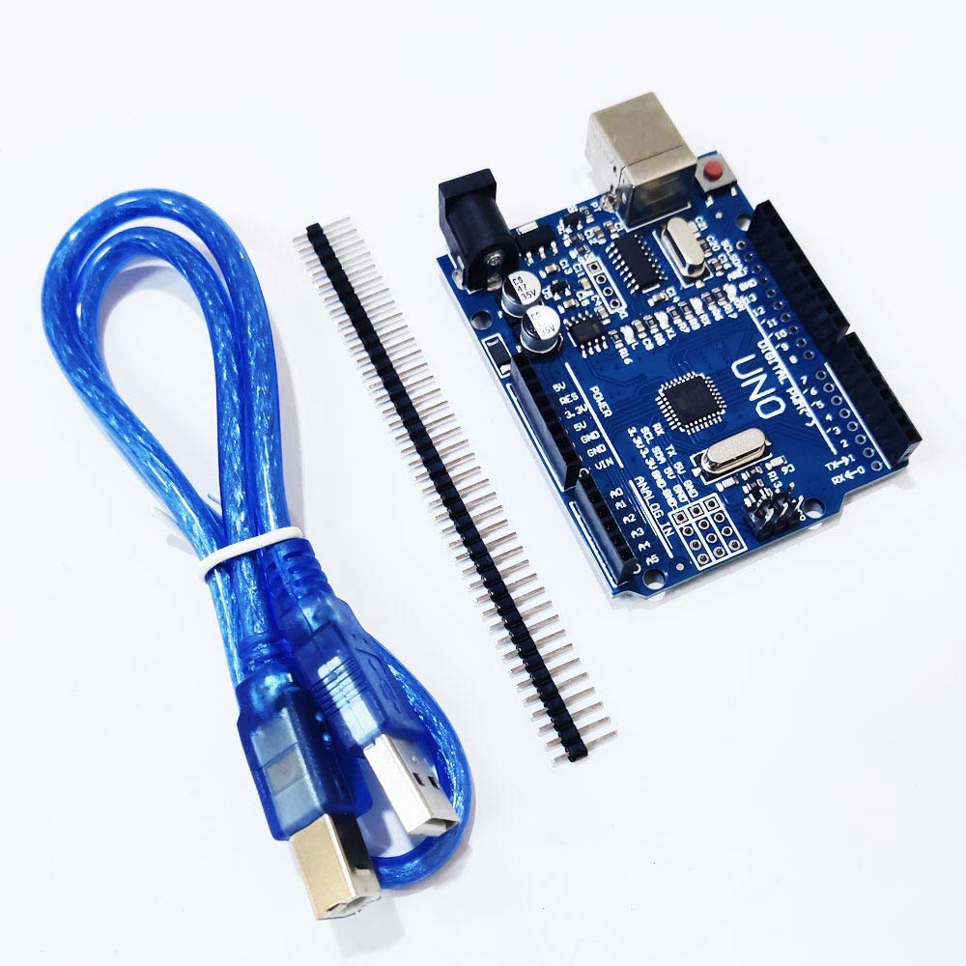
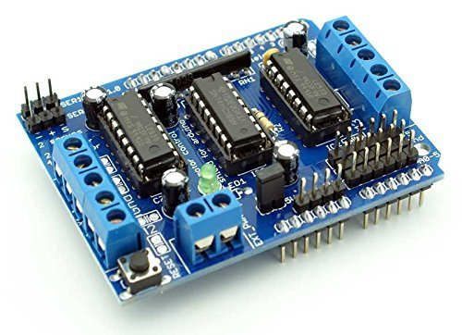
Components used in our project
1. ARDUINO UNO R3
The Arduino Uno R3 is a microcontroller board based on a removable, dual-inline-package (DIP) ATmega328 AVR microcontroller. It has 20 digital input/output pins (of which 6 can be used as PWM outputs and 6 can be used as analog inputs).
2. MOTOR DRIVER STEPPER SERVO SHIELD
The Motor Shield is equipped with two L293D motor drivers and offers 4 H-bridges. This shield supports up to 4 DC motors, 2 stepper motors or 2 servos and can be connected to your Arduino Uno or Mega. to add text

Slide 4
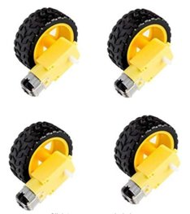
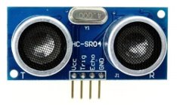
3. GEAR MOTOR WITH WHEELS
Four sets of DC motors and wheels, it has an anti-interference ability.
Ideal for robotic platforms, line-tracing robots, etc.
The wheel can be mounted on either side.
The gear motor works well between DC 3V and 6V.
4. ULTRASONIC SENSOR
The Kitronik ultrasonic distance sensor HC-SR04 5V version has been specially selected to work on the voltage range typically found with the Arduino range of products. Each HC-SR04 module includes an ultrasonic transmitter, a receiver and a control circuit.
This economical sensor provides 2cm to 400cm of non-contact measurement functionality It offers ranging accuracy that can reach up to 3mm
to add text.

Slide 5
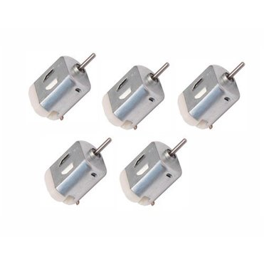
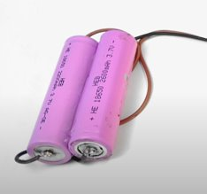
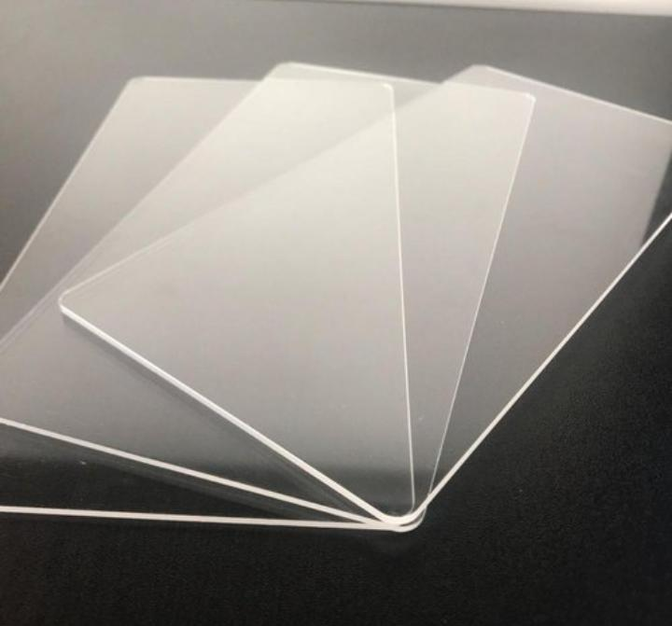
5. A 6V Motor which is needed to generate vacuum in our bottle.
6. A lithium-Ion Battery which is used to power the device
7.Acrylic or Wooden Sheet

Slide 6
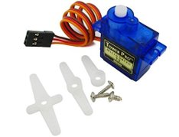
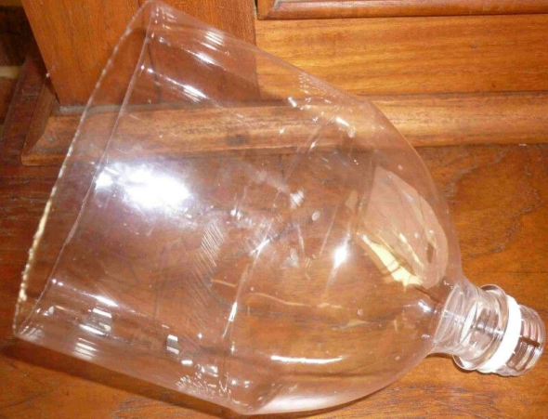
9. Servo Motor and Jumper wires
Operating speed: 0.12second/ 60degree ( 4.8V no load)
Stall Torque (4.8V): 17.5oz /in (1kg/cm)
Operating voltage: 3.0V~7.2V
Temperature range: -30 to +60
Dead band width: 7usec
10. Upper Section of a Plastic Water Bottle
This will be used to store the dirt collected by the nozzle of the vacuum cleaner

Slide 7
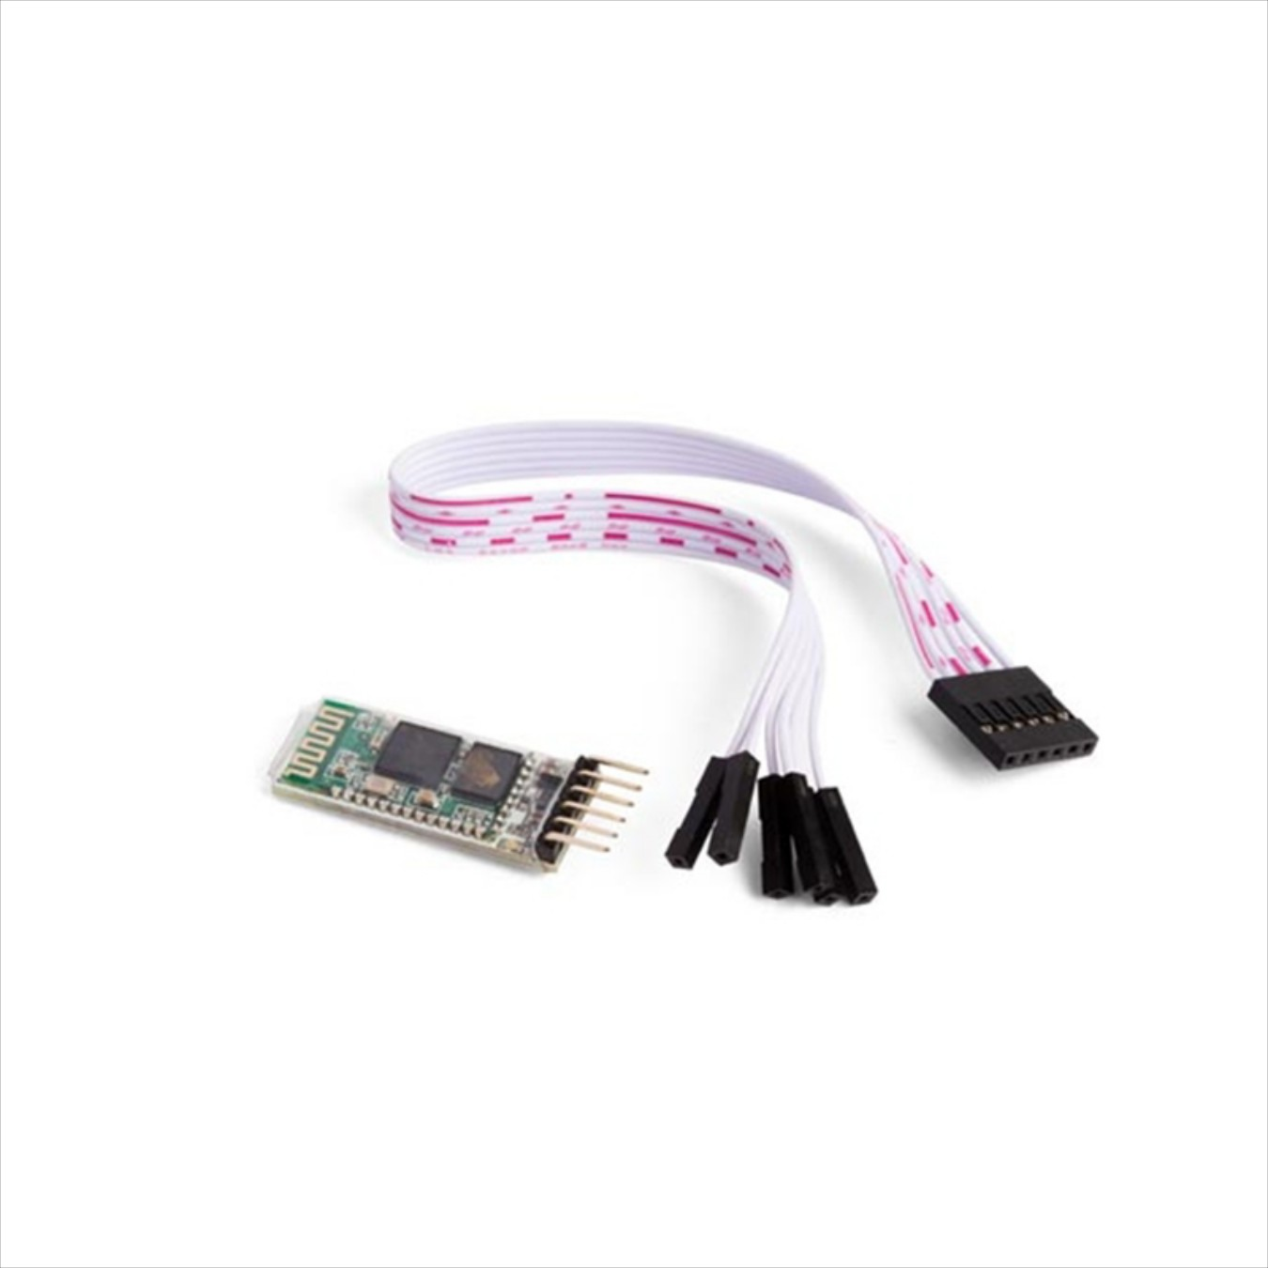
11. HC-05 BLUETOOTH MODULE
HC-05 Bluetooth Module is an easy to use Bluetooth SPP (Serial Port Protocol) module, designed for transparent wireless serial connection setup. Its communication is via serial communication which makes an easy way to interface with controller or PC.

Slide 8

Work Plan
Collecting all the above parts
Assembling the parts
Making the main body of the robotic vehicle using an acrylic sheet or a piece of wood
Mounting the Arduino and other components over the base of acrylic sheet
Testing the moving ability of our car
Then connecting all the required parts to the necessary points in the circuit to complete the circuit.
After the car can move we will mount the half section of the water bottle over it and use a toy fan which is used as a rotor for our cleaner
Writing the code for our vehicle on Arduino
Then we will connect our vehicle with a Bluetooth Module which will enable it to navigate efficiently.
Finally, some final tests will be done to test the overall efficiency of our device

Slide 9
WEEKLY PROGRESs
WEEK 1-2 : During this time, we were initially selecting the project and after we had done that we began researching on our project and started ordering parts that are required.
WEEK 2-4 : This week was spent on working on the hardware elements and putting together the code of our vehicle. It was also during time that we ordered our Bluetooth module.
WEEK 5-6: This time was spent into working on the final developments of our project. We finished compiling the code and assembled the hardware elements into a functioning vacuum cleaner. It is during this time that we began writing our report

Slide 10
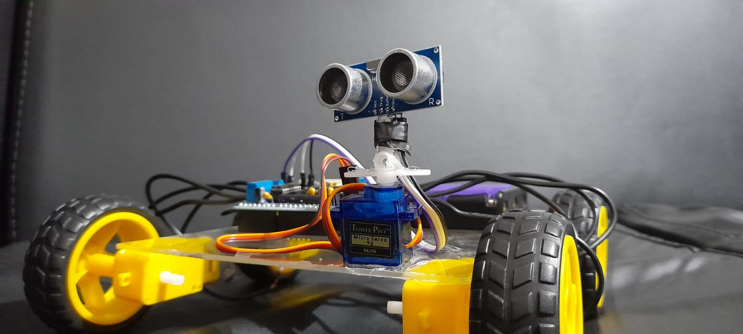
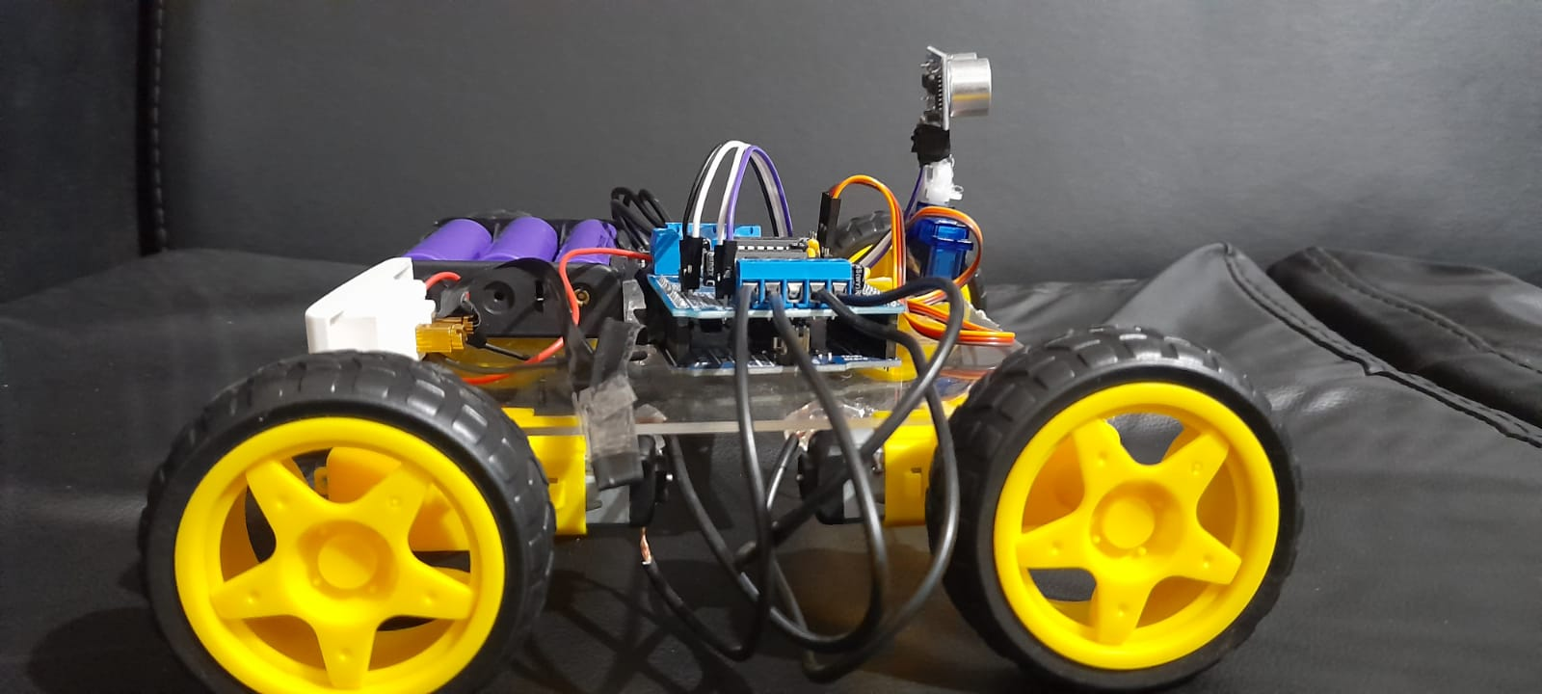
Progress via images
Stage 1 of the Car

Slide 11
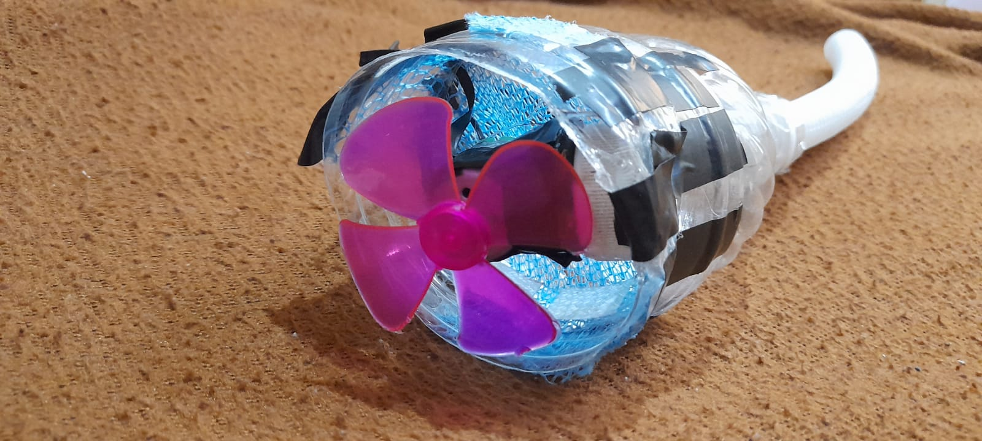
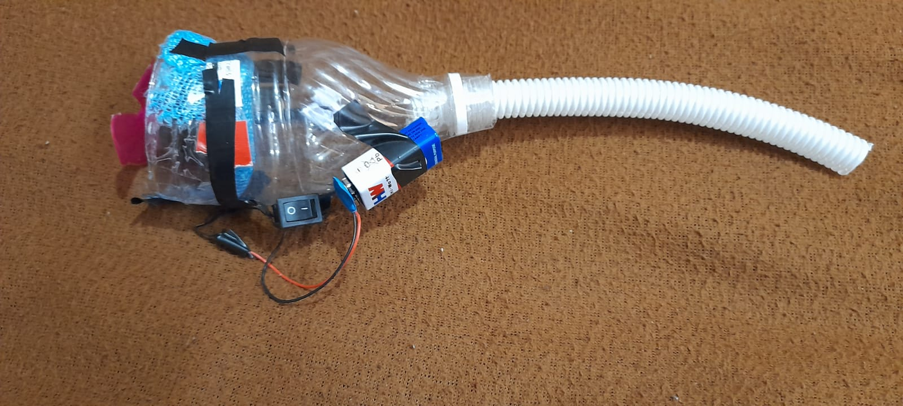
Stage 1 of Vacuum Cleaner

Slide 12
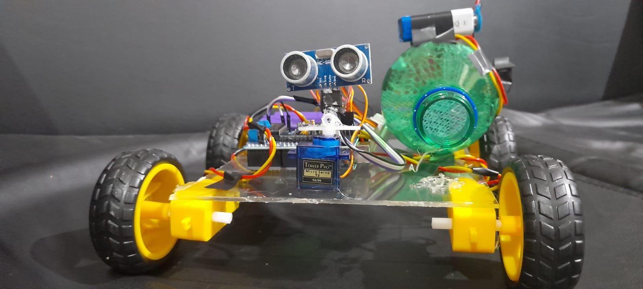
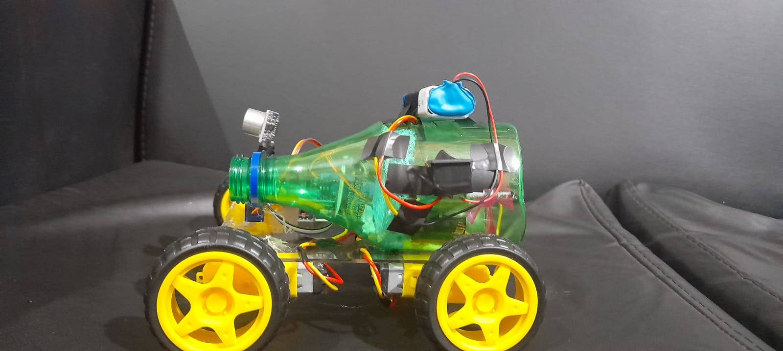
Secondary Stage of the AVC

Slide 13
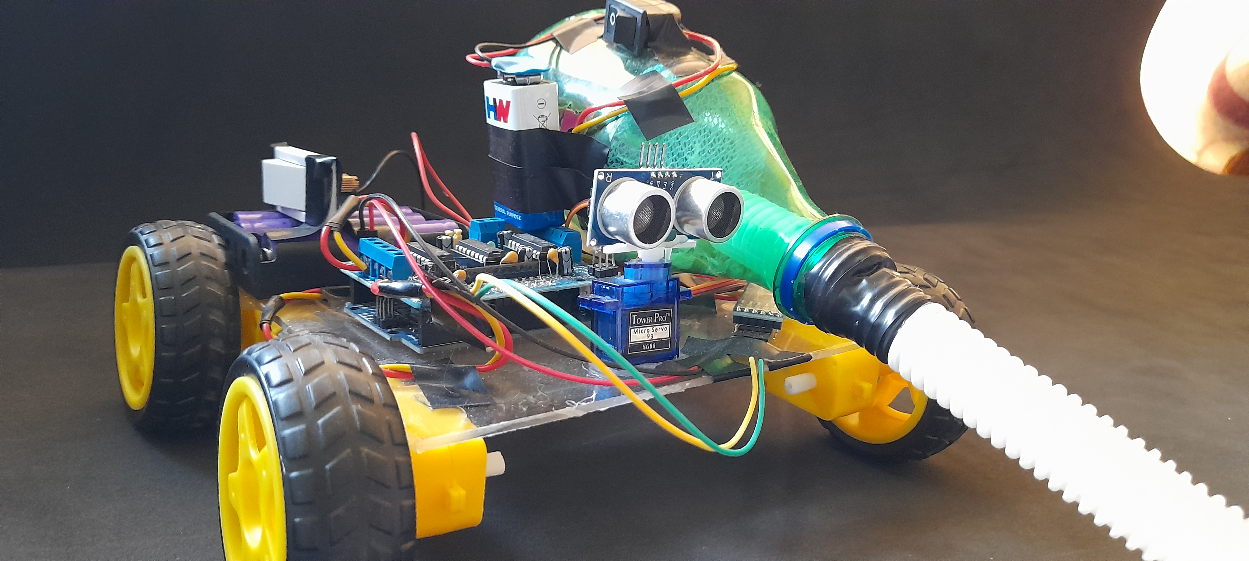
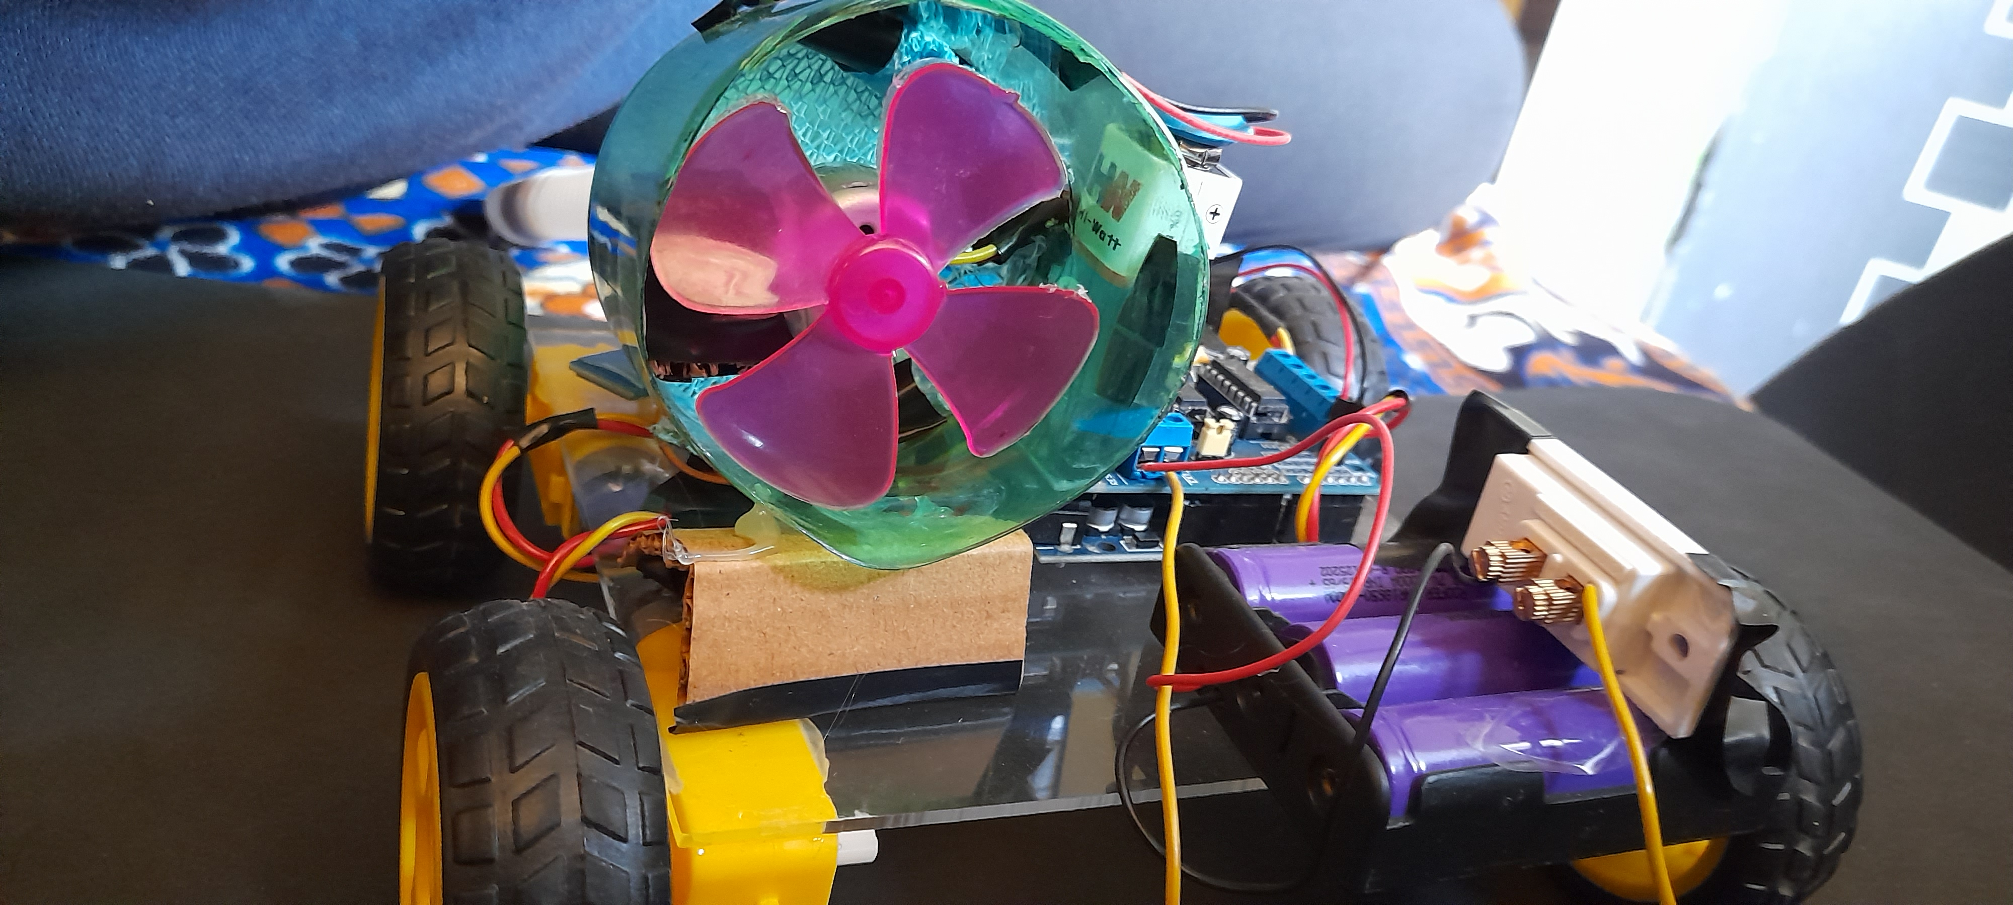
THE FINAL STAGE

Slide 14
Suggestions by OUR PROFESSORS
We were suggested by the professors to change the position of the bottle and reduce the bottle size. We have made those changes in the vacuum cleaner as initially it was not creating enough suction. Now we reduced the size of the bottle to fix it according to the Bernoulli's equation. Also, we were asked about the mobility issue of our device and to fix that changed the gear motor which was initially hindering the movement of the vehicle and causing the problem. Here are some of the new developments in our project. Also, as sir said we have also made the car to able to move up or down an incline.

Slide 15
Some images of our final project are

Slide 16
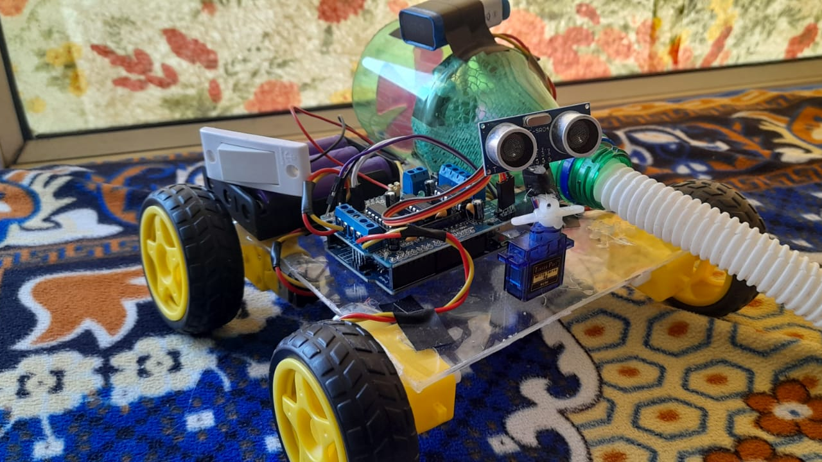

Slide 17
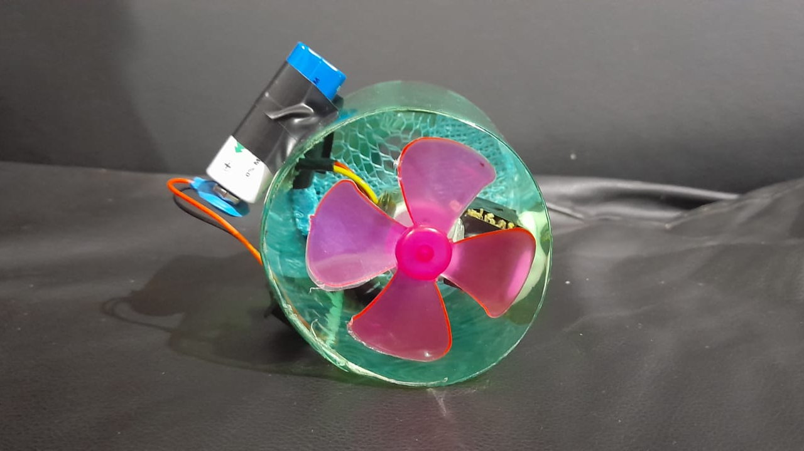

Slide 18
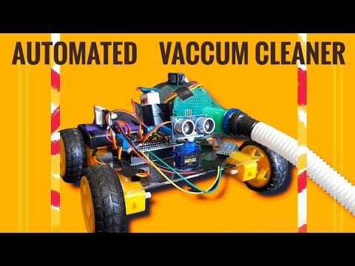
HERE IS OUR VIDEO

Slide 19
Contributions by Team Members
1. Kaisar Imtiyaz: Code Development, research and presentation.
2. Sumat Midya Chowdhuri: Circuit Designing, Research.
3.Ajay Kumar: Assembling parts and working on the hardware.
4. Harsh Sharma :Assembling Parts and working on the hardware.

Slide 20
Conclusion
After all the work which was done it is confident to say that this Automated Vacuum Cleaner gives a lot benefits not to just us , but also to the environment in general . Plus , with the convenience and user-friendly nature that the AVC offers to the people , it helps immensely especially in process of cleaning in the house be it on any sort of surface. We believe that our project has immense potential for the future. We can hopefully make more upgradations to the AVC such as adding more Ultrasonic sensors enabling it to detect obstacles from all sides and thus making it multi directional. We also look to increase the storage tank and the size of the entire model such that it can be used at a large scale. All the upgrades and improvements will be made so that this project could give more benefits and advantages . Hence, hope that this project could expand even more throughout all the upcoming generations.

